Slide 1
Exercise 1
Biodiversity in Chicago

Slide 2
In this exercise, you were introduced to the biodiversity and natural history of the Chicago region. In addition, you identified trees on campus using a dichotomous key. You should know the features and recognize images of different habitats in the Chicago region. On this page, you will find photos of leaves from campus trees which you can use to test your vocabulary of leaf morphology. You will be expected to use this vocabulary and know how to use a dichotomous key to identify trees. For each photo, decide if the leaves are deciduous or evergreen. If they are deciduous: Are they arranged opposite or alternate? Are they simple or compound leaves? Are the veins arranged in a pinnate or palmate pattern? What term would be used to describe the leaf shape? What term would be used to describe the leaf margin? If the leaves are evergreen: Are these leaves needle-shaped, awl-shaped or scale-shaped? Are these leaves bundled or not?

Slide 3
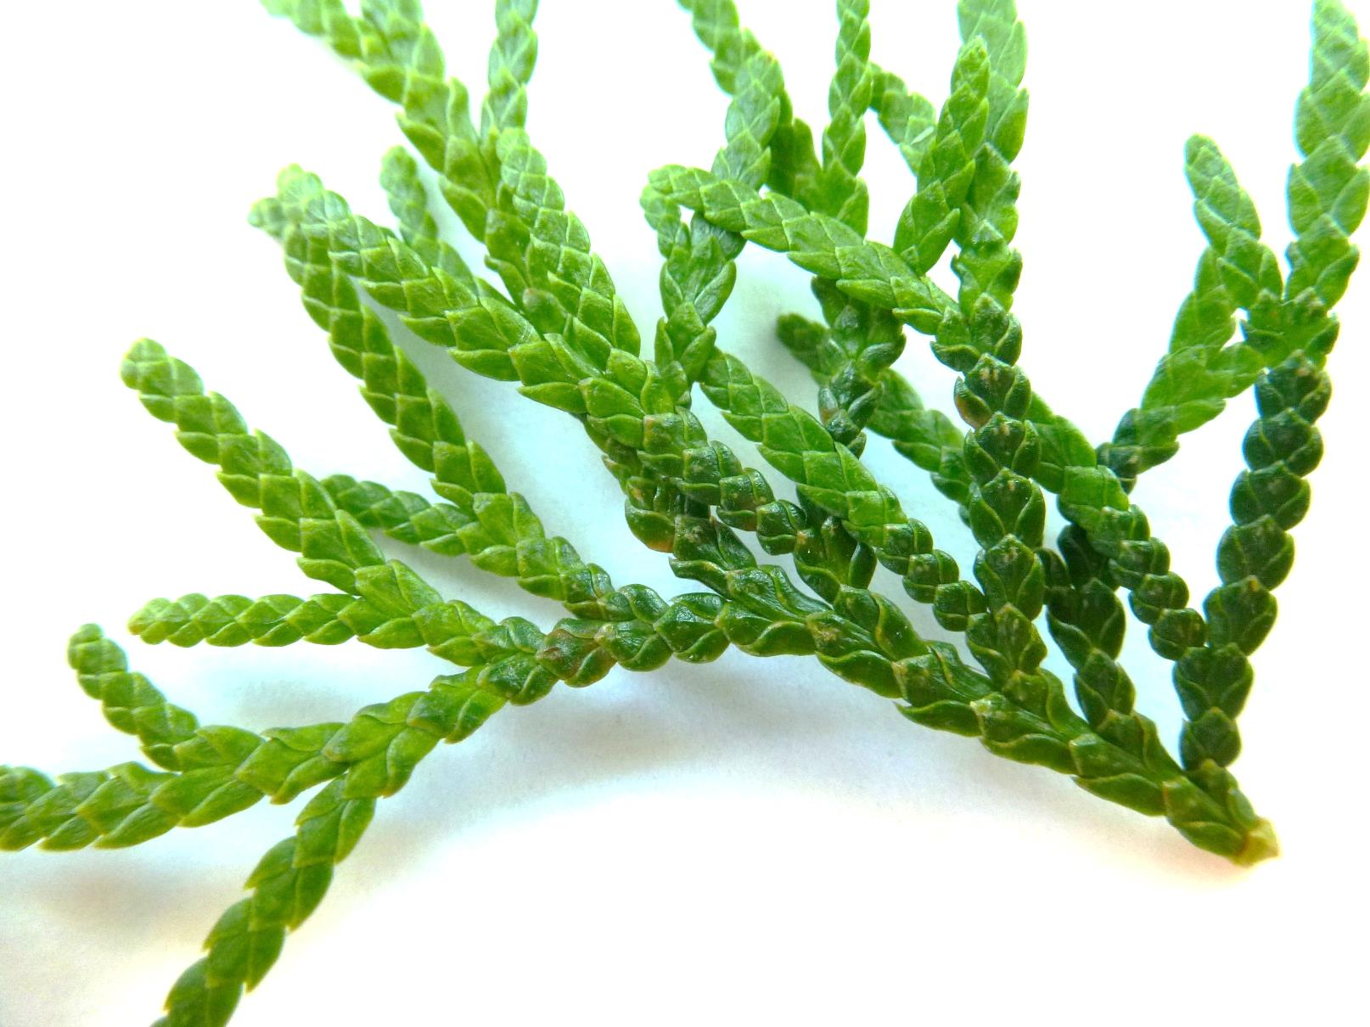
Note to Brittany: the pictures on this page will not be labeled.

Slide 4
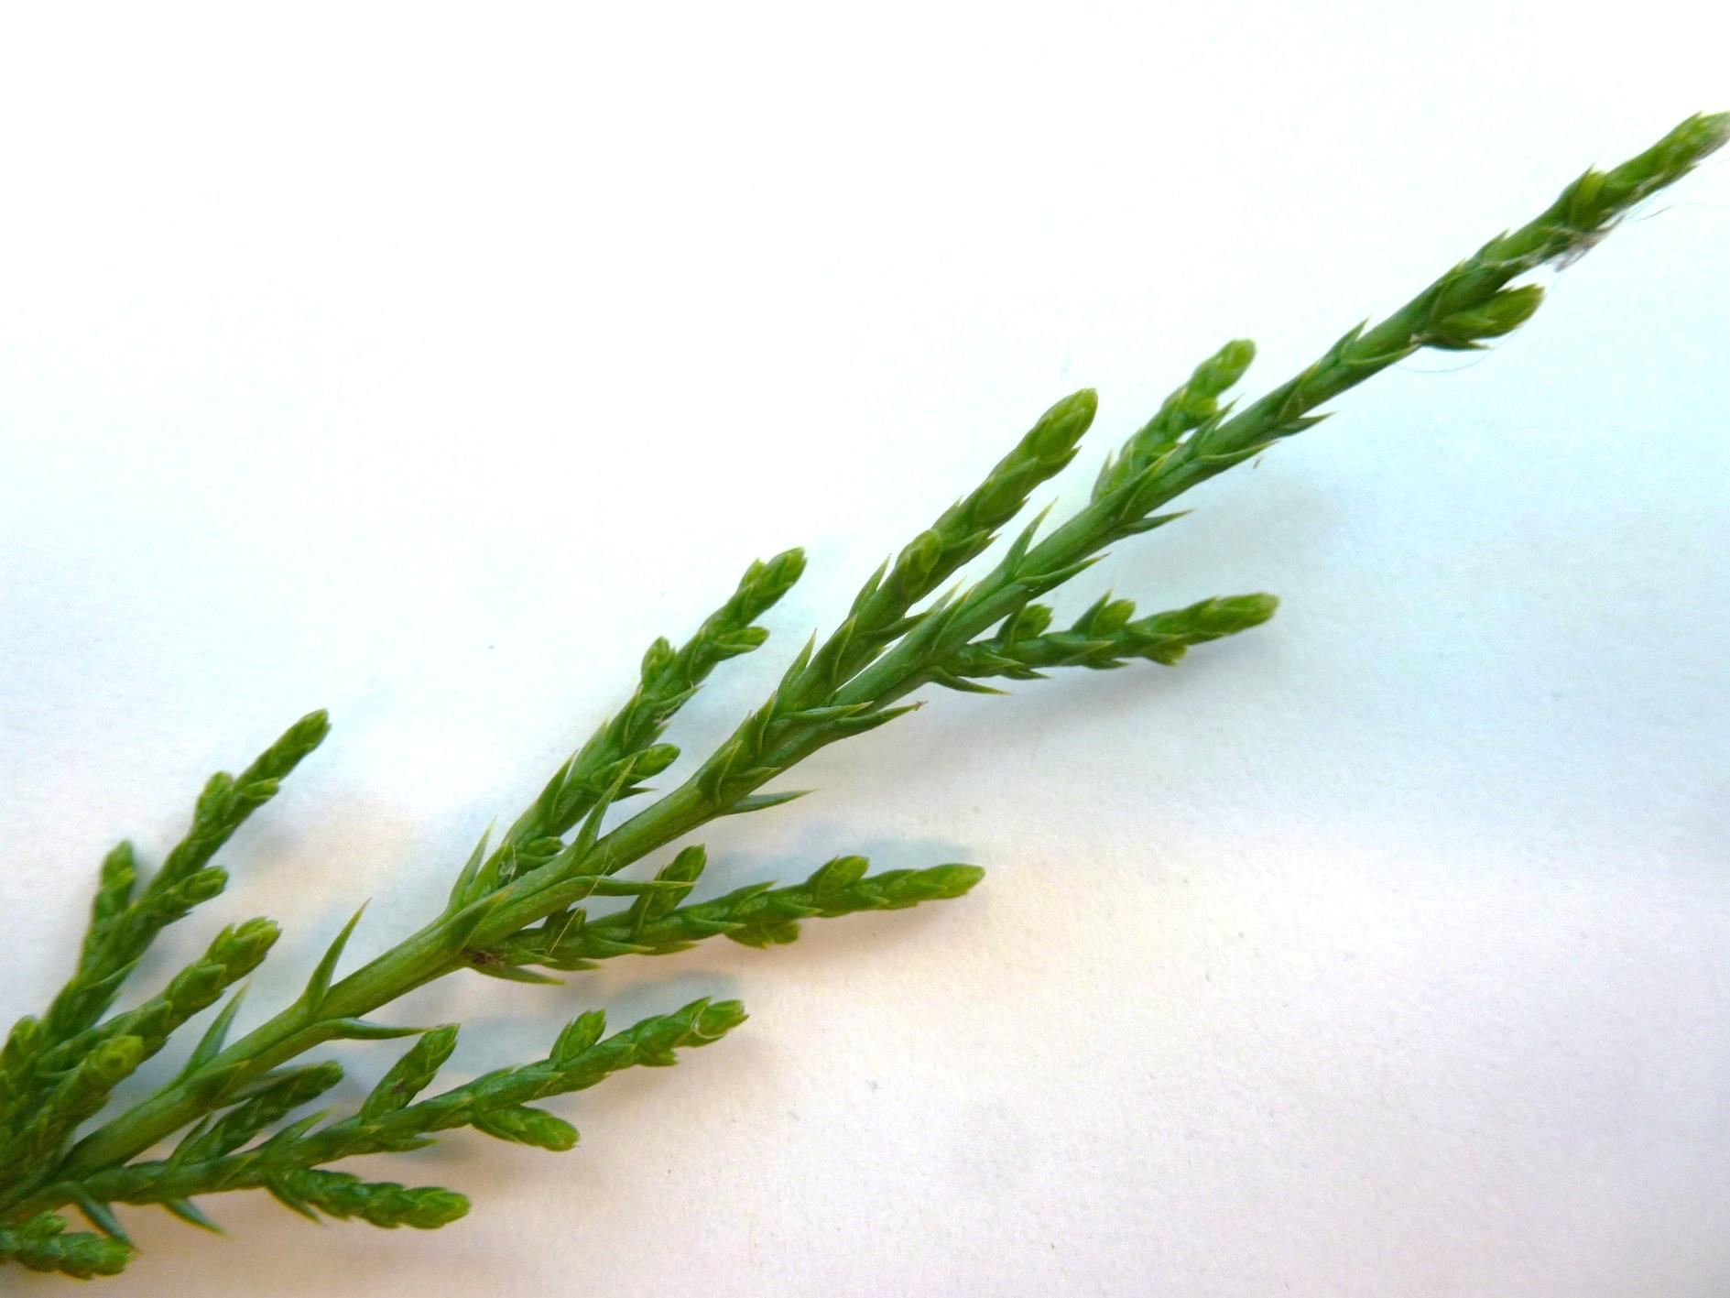

Slide 5
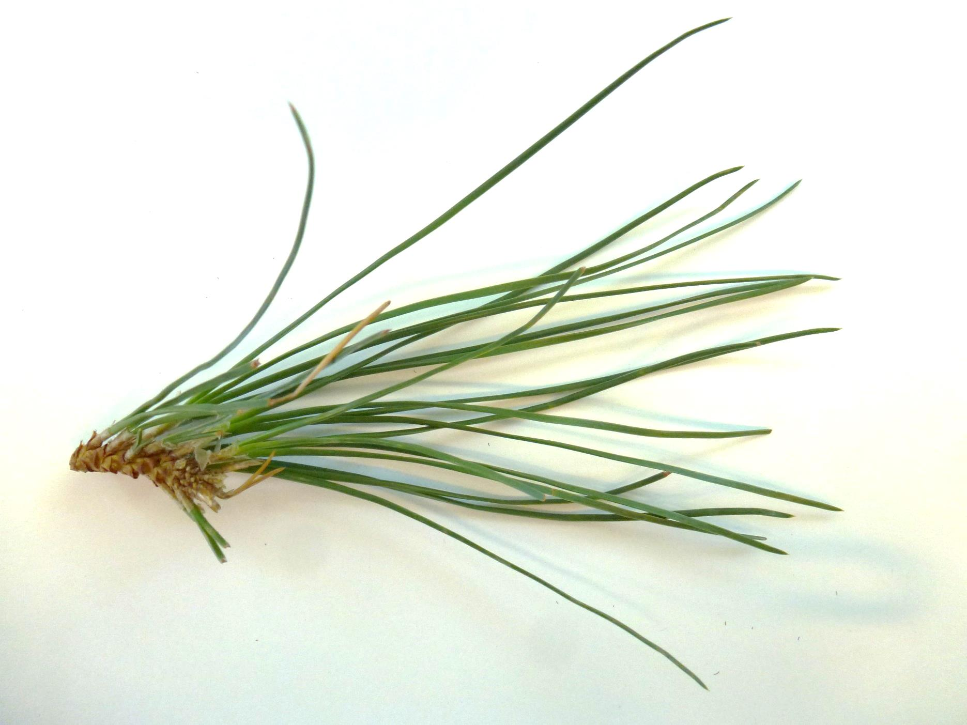

Slide 6
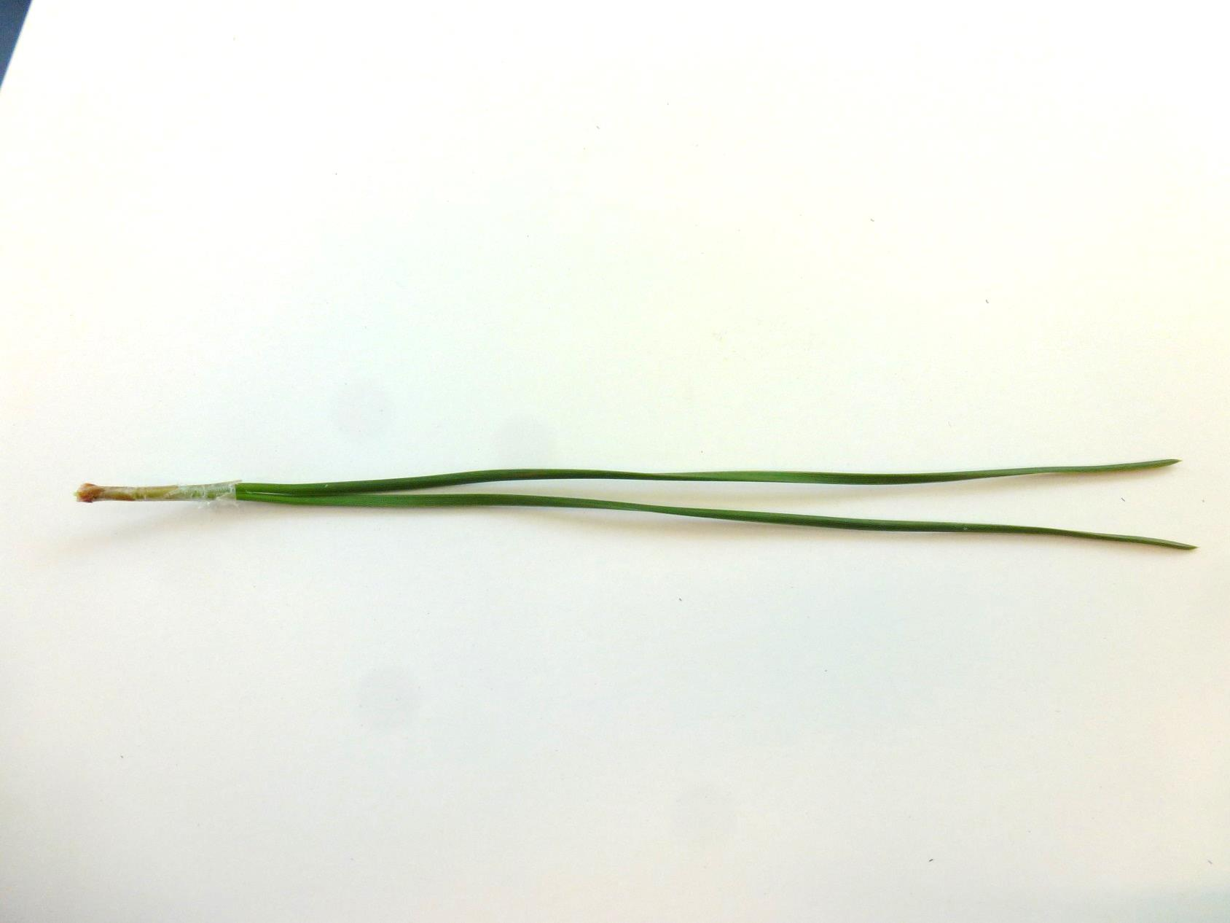

Slide 7
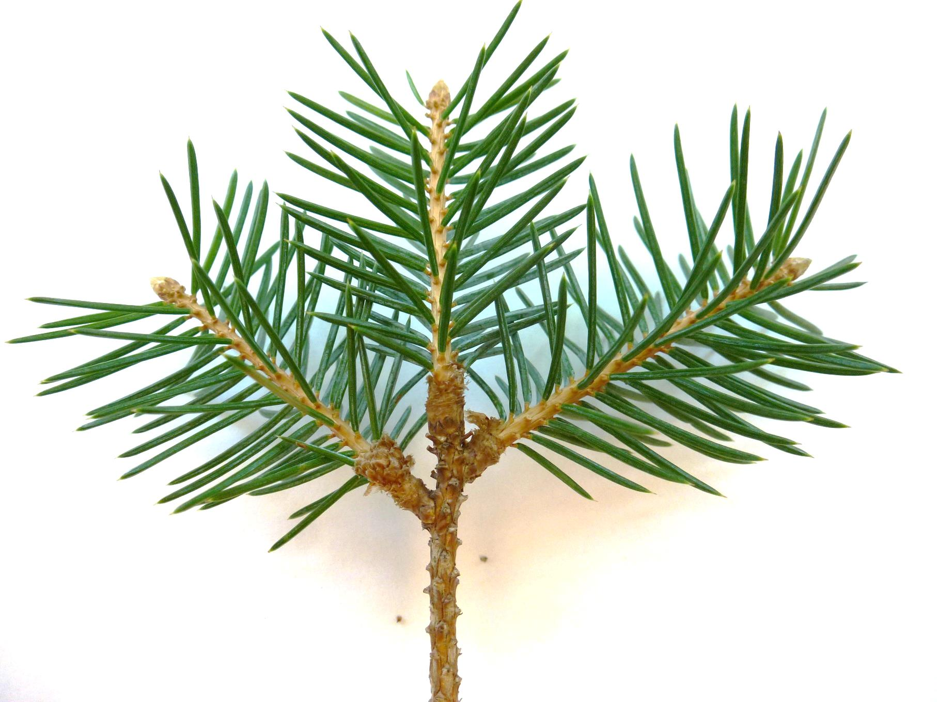

Slide 8
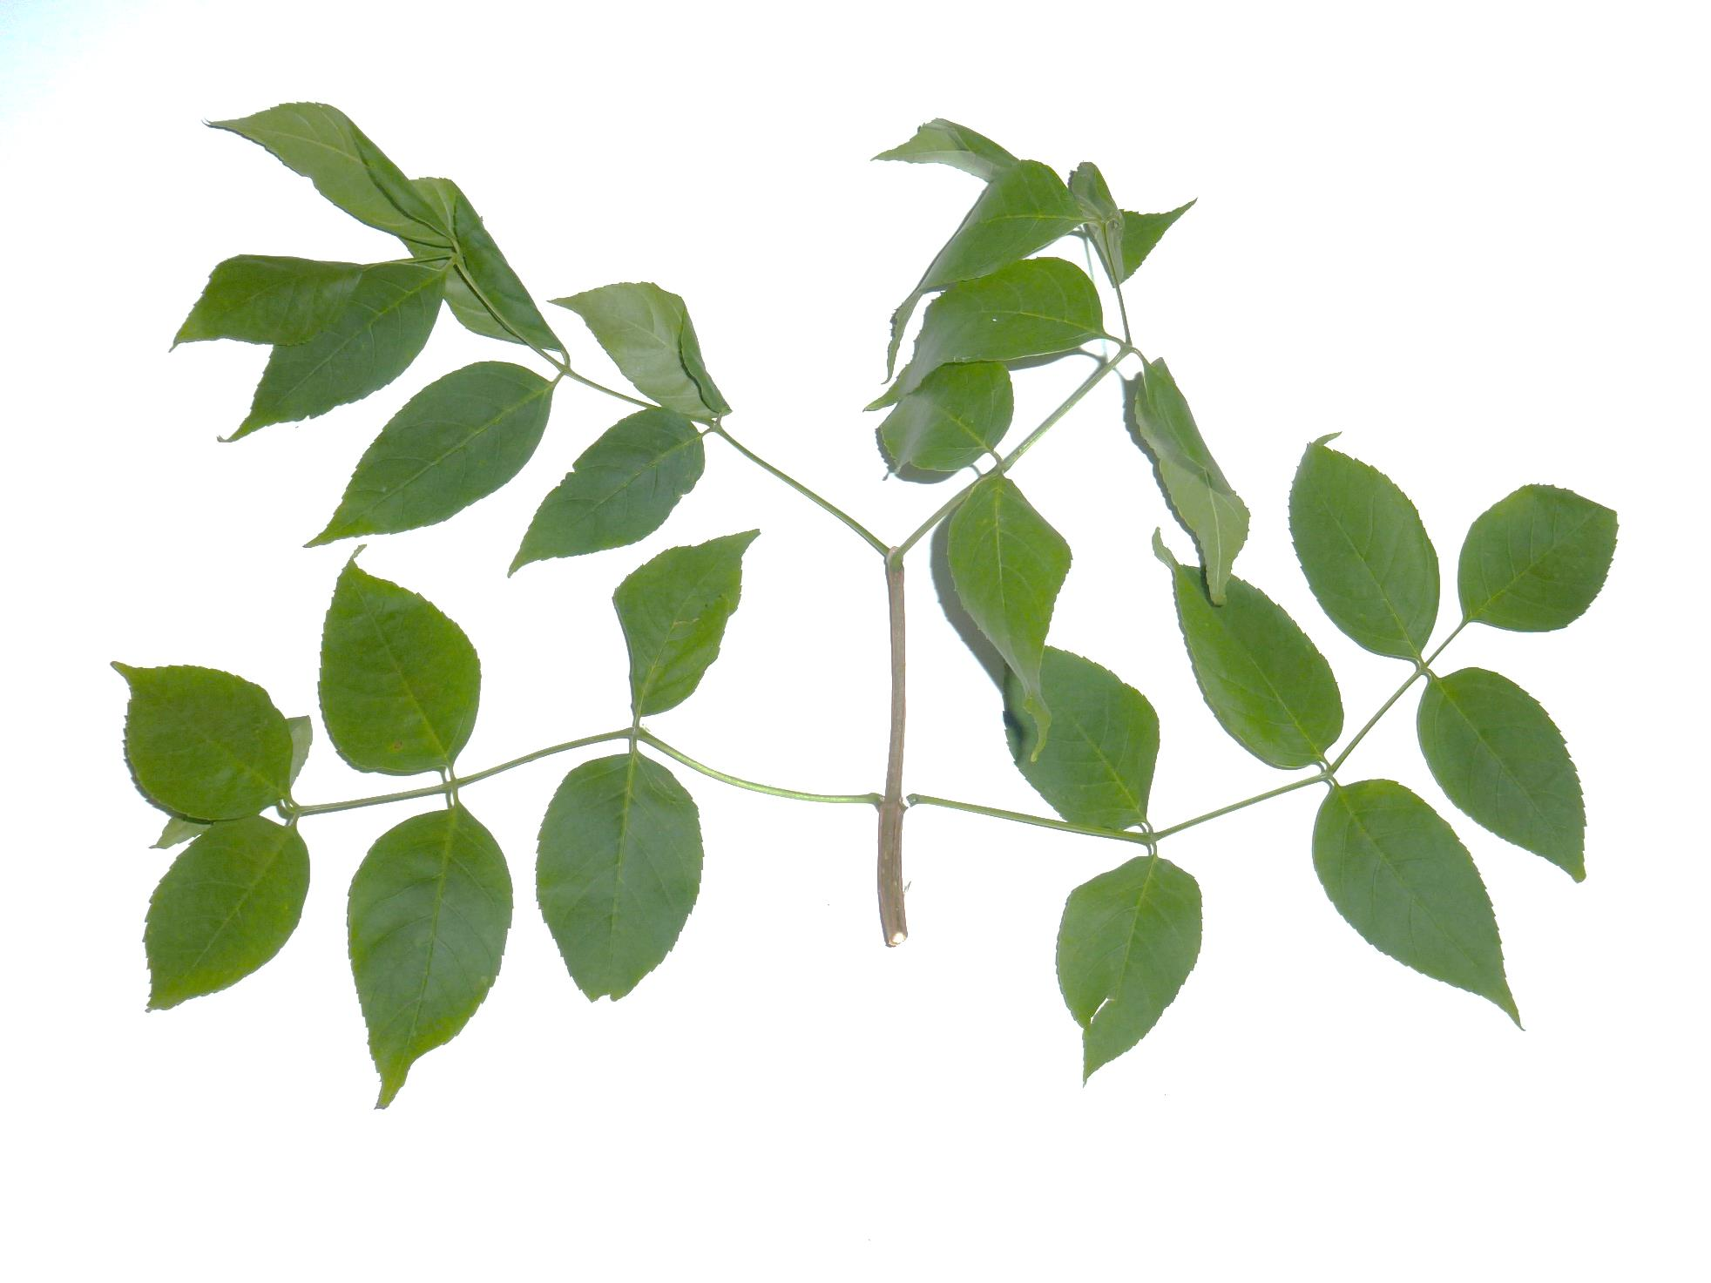

Slide 9
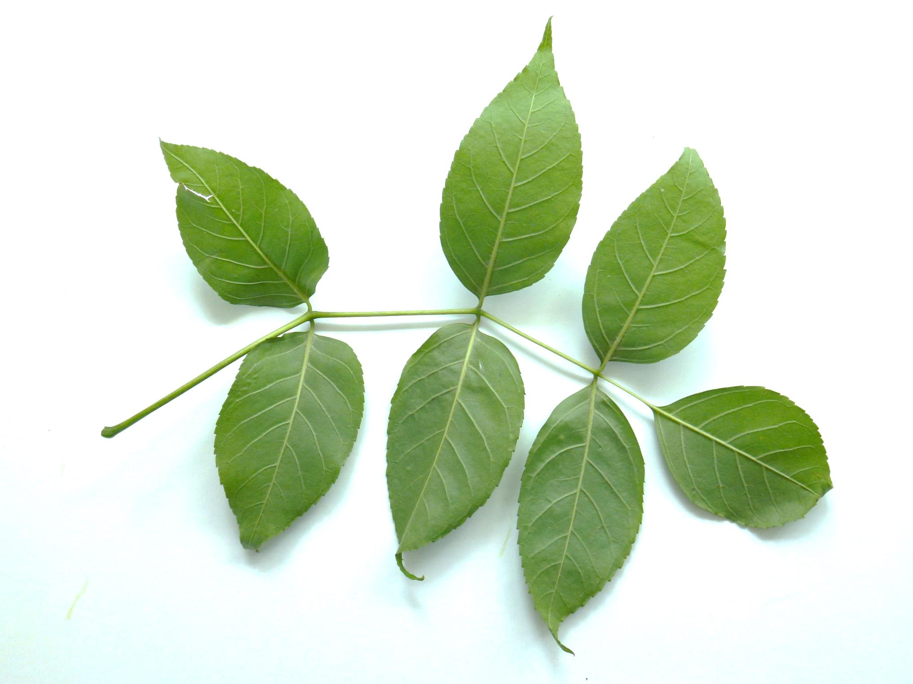

Slide 10
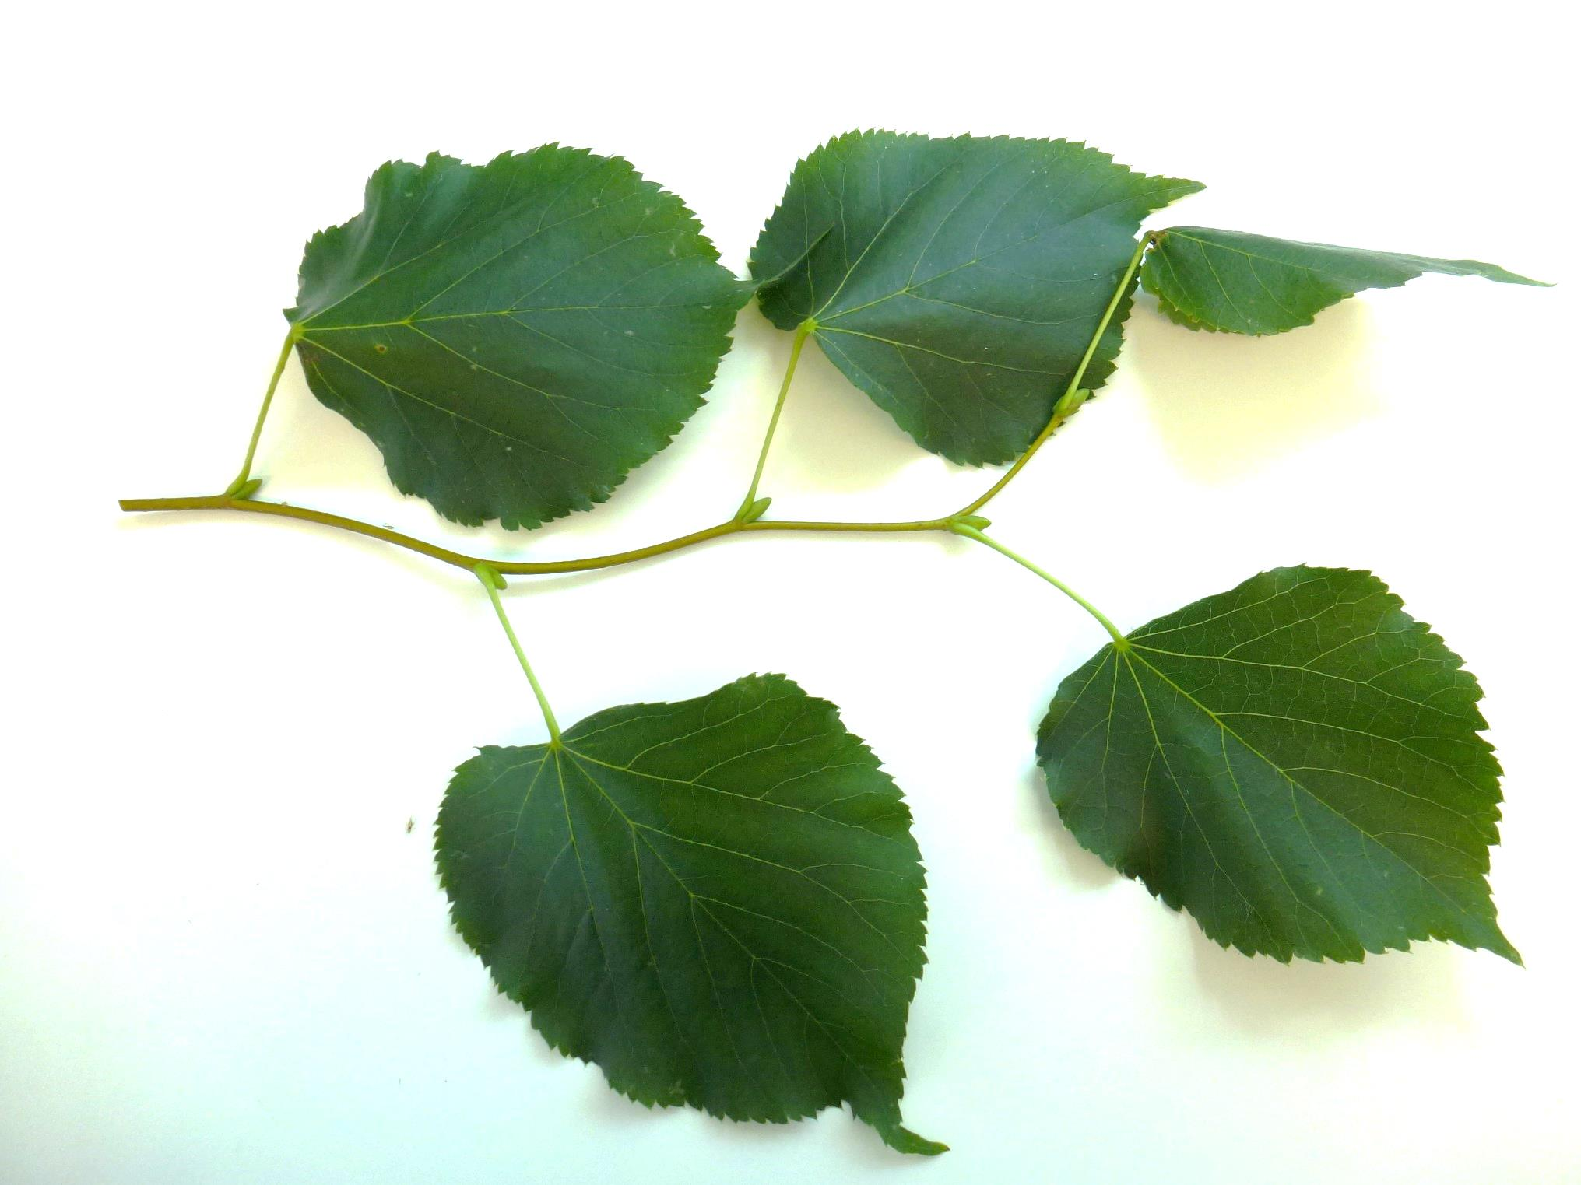

Slide 11
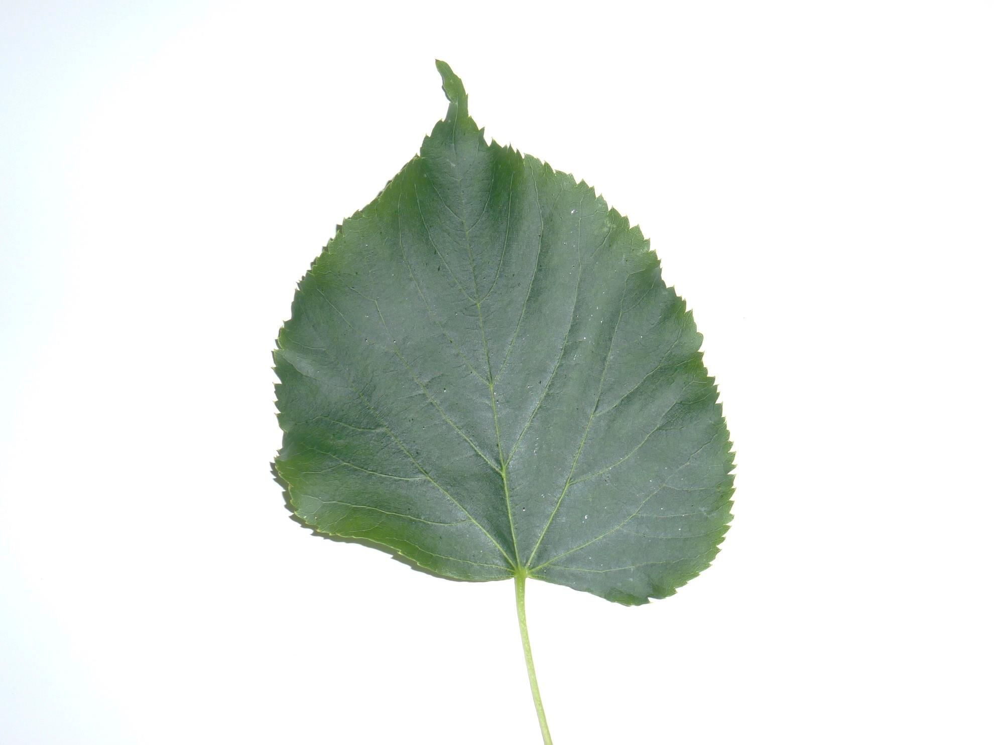

Slide 12
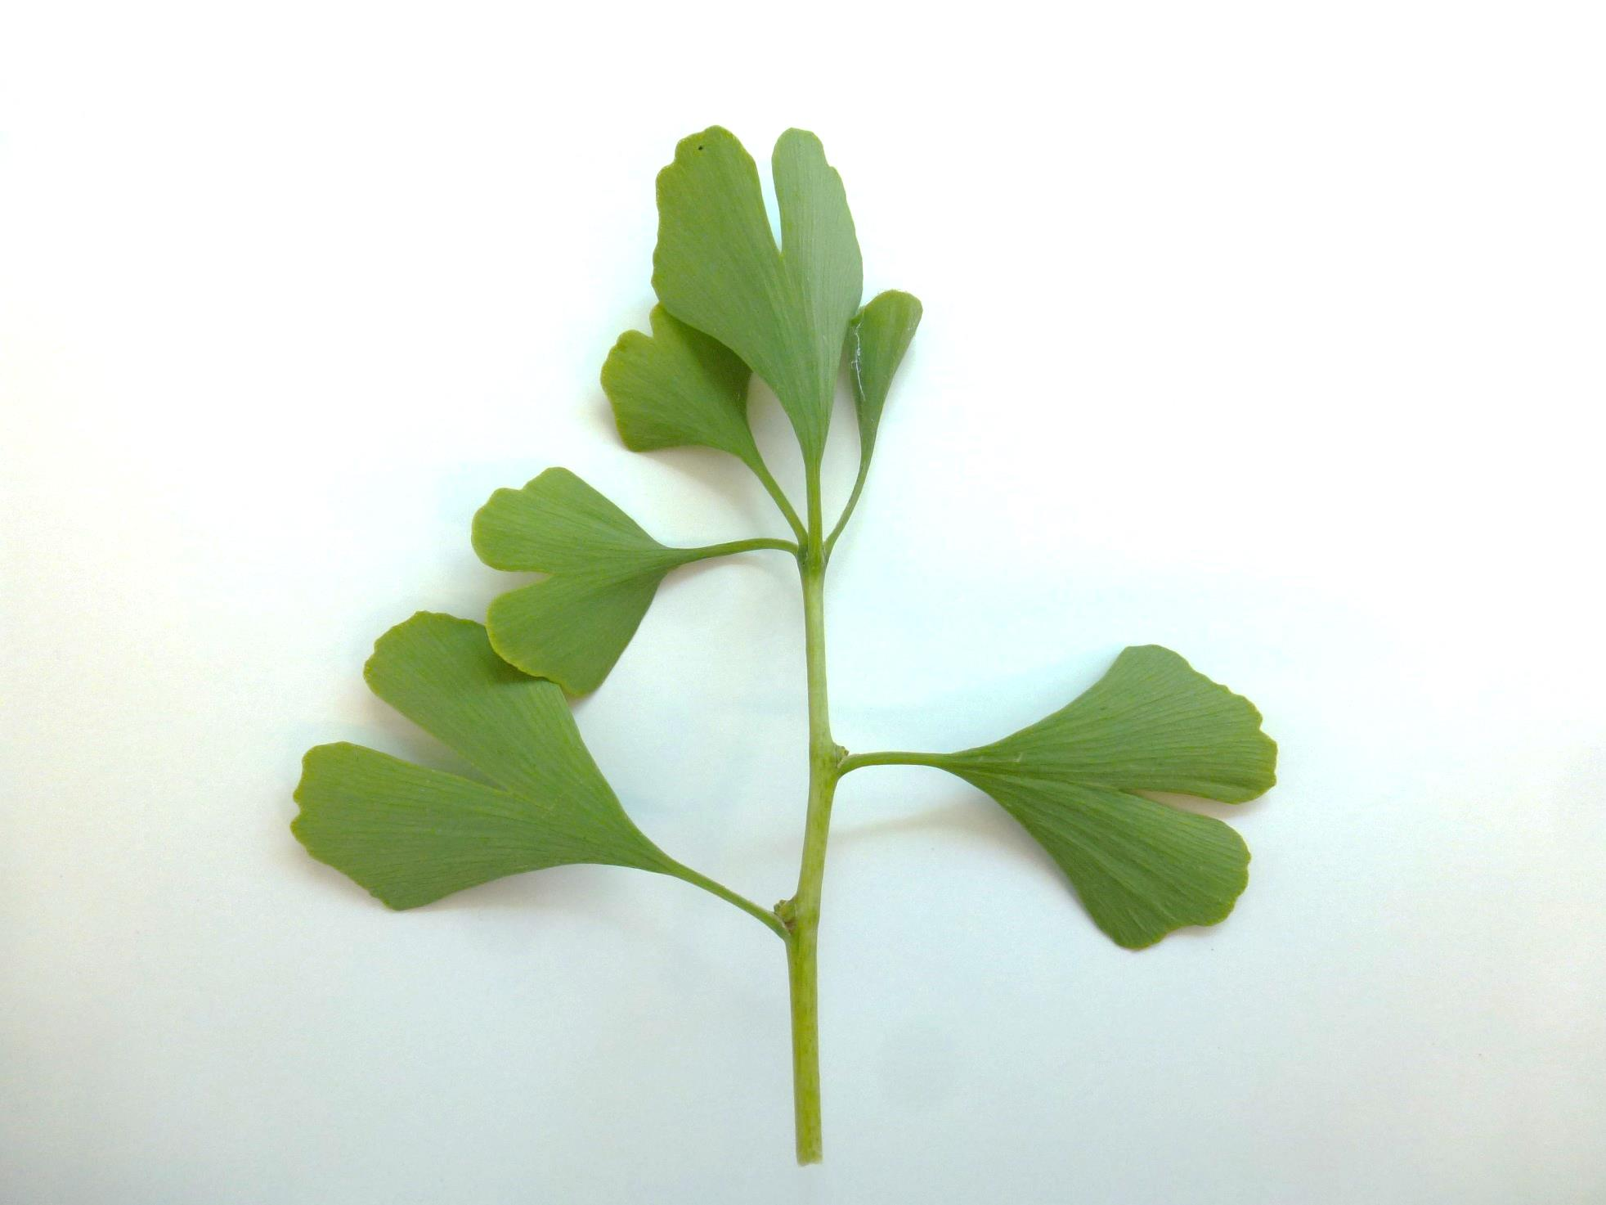

Slide 13
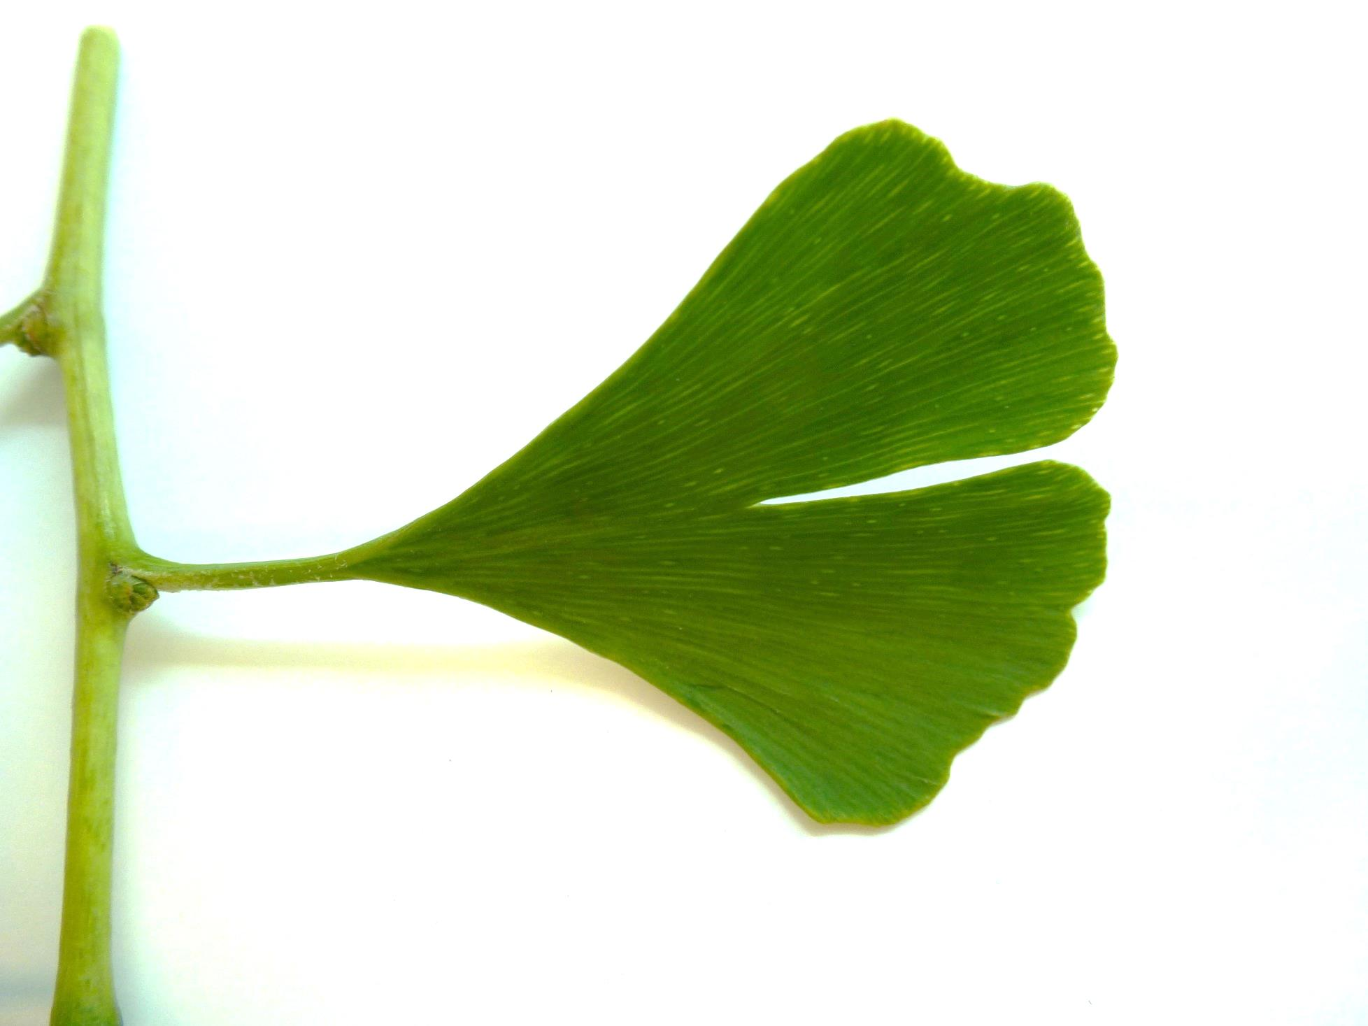

Slide 14
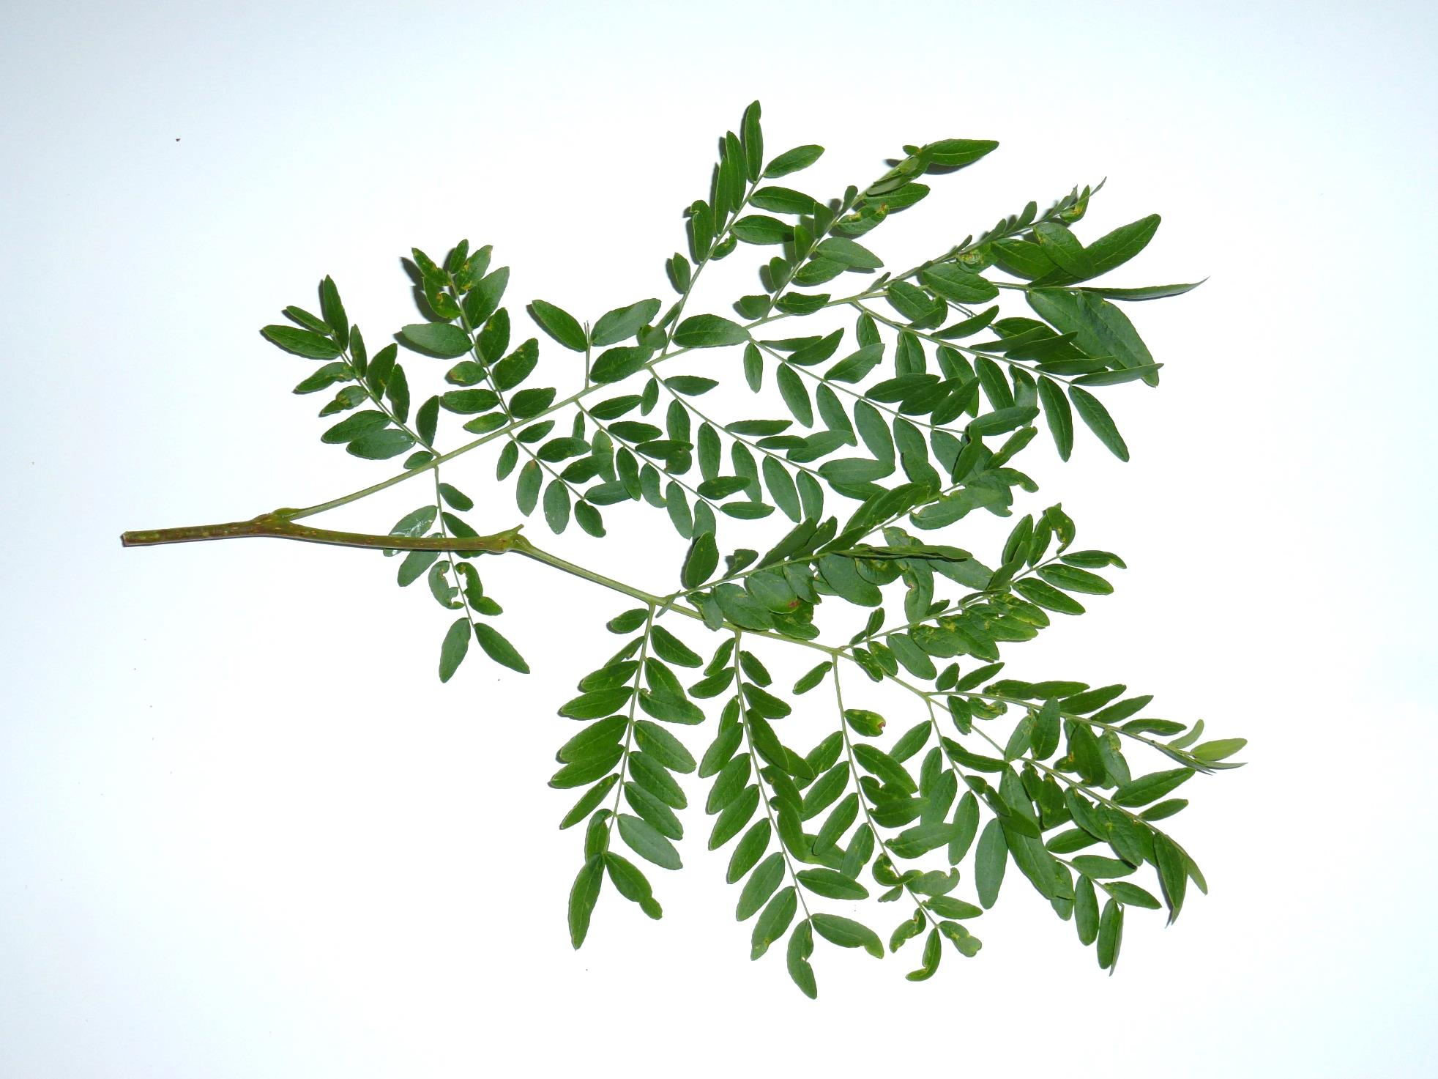

Slide 15
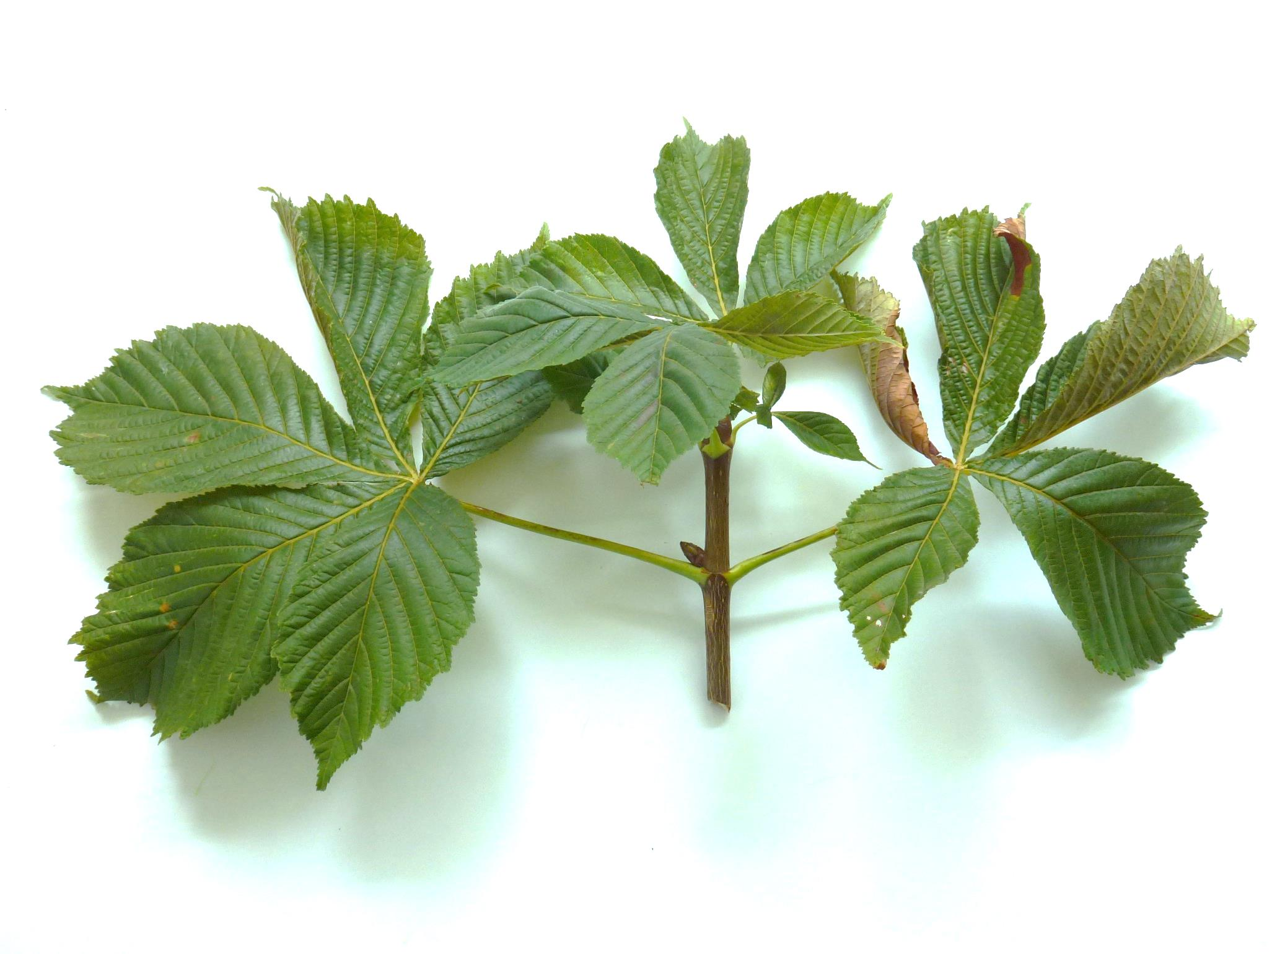

Slide 16
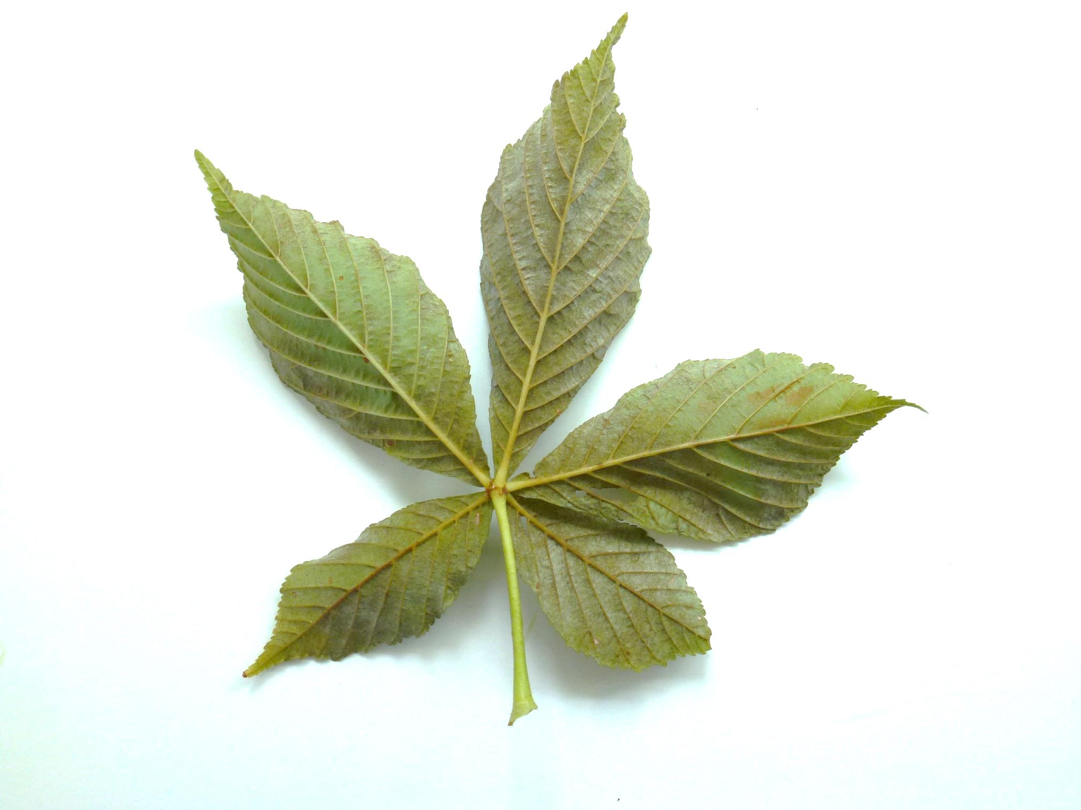

Slide 17
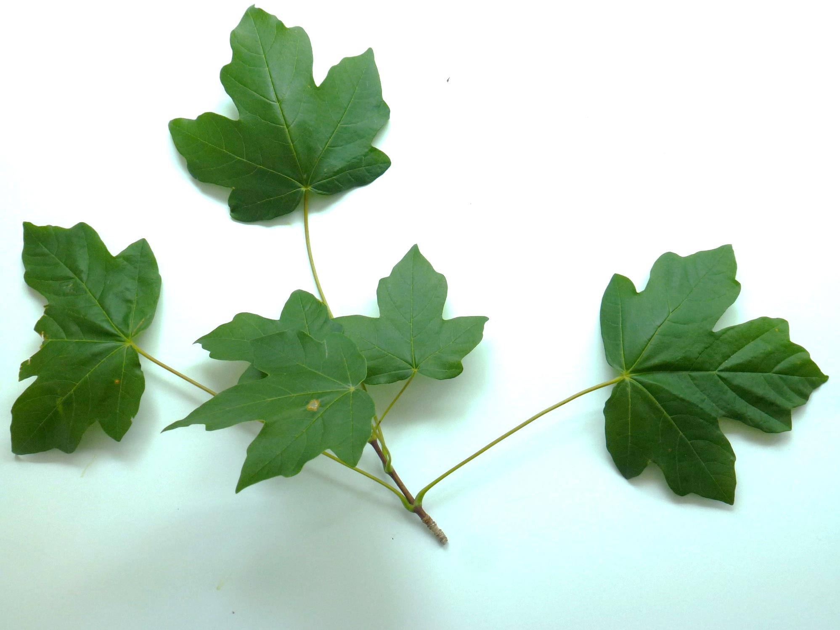

Slide 18
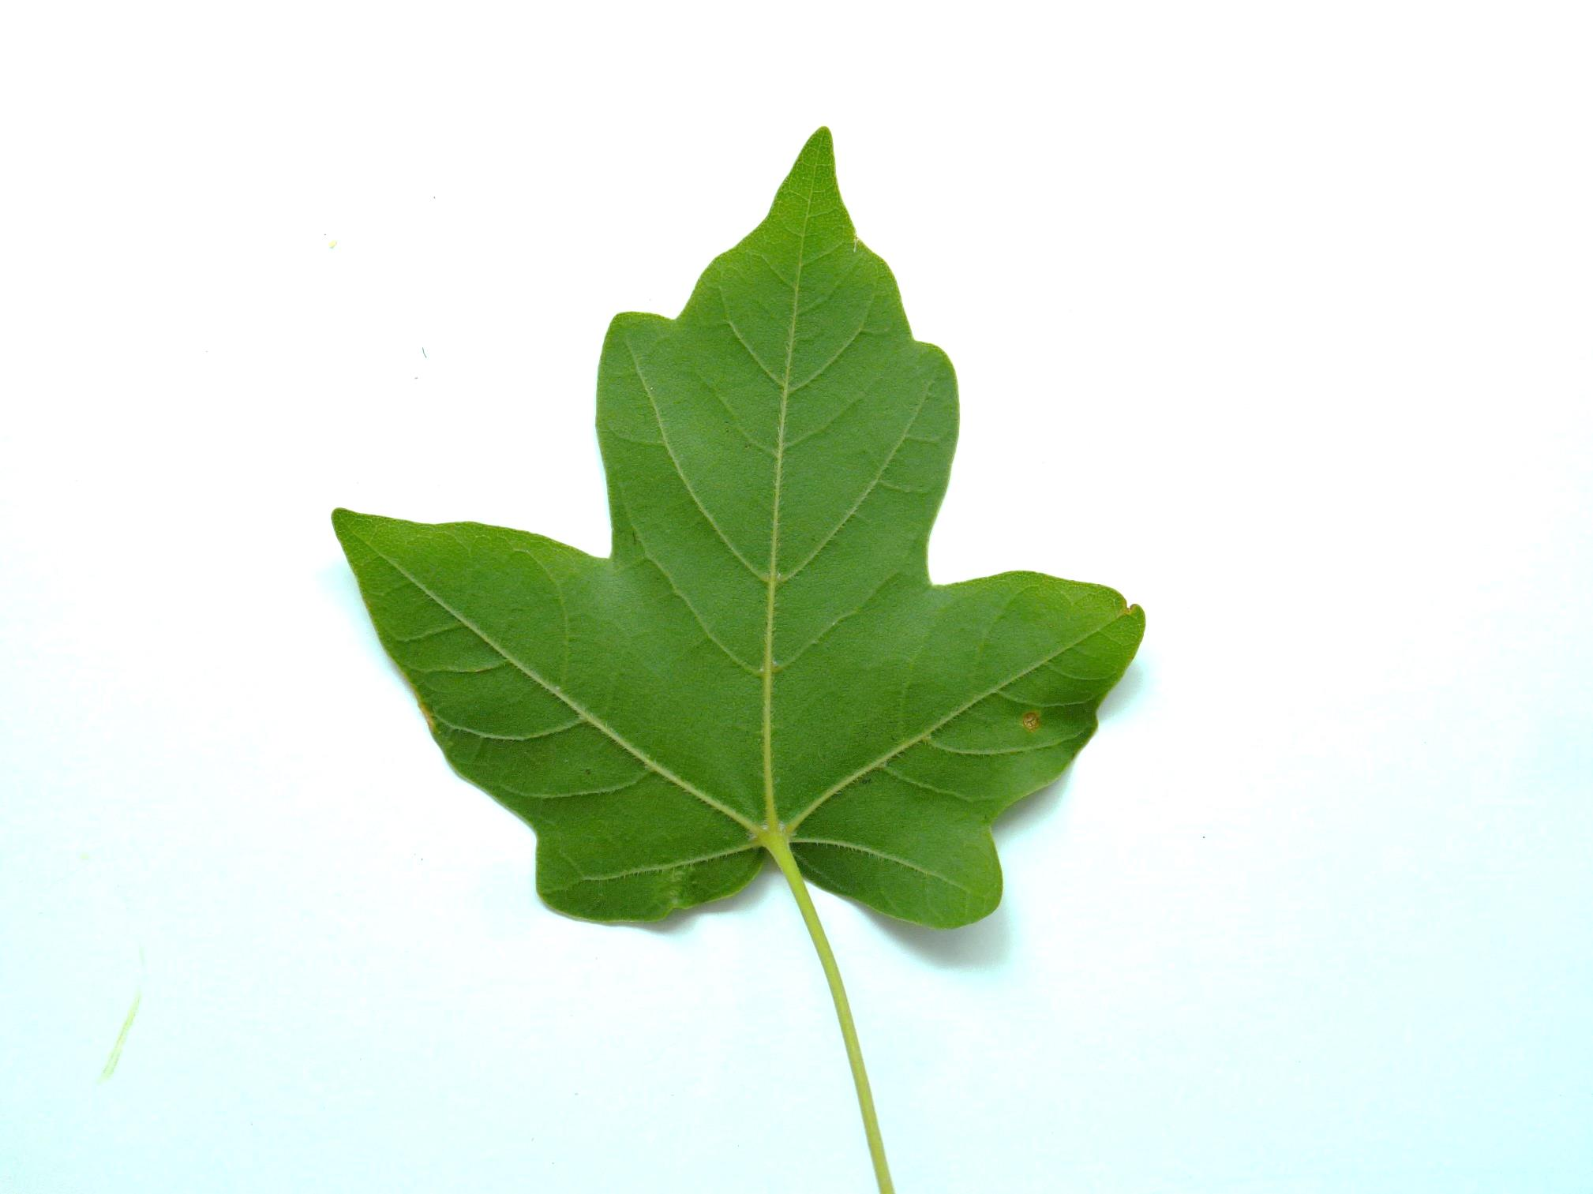

Slide 19
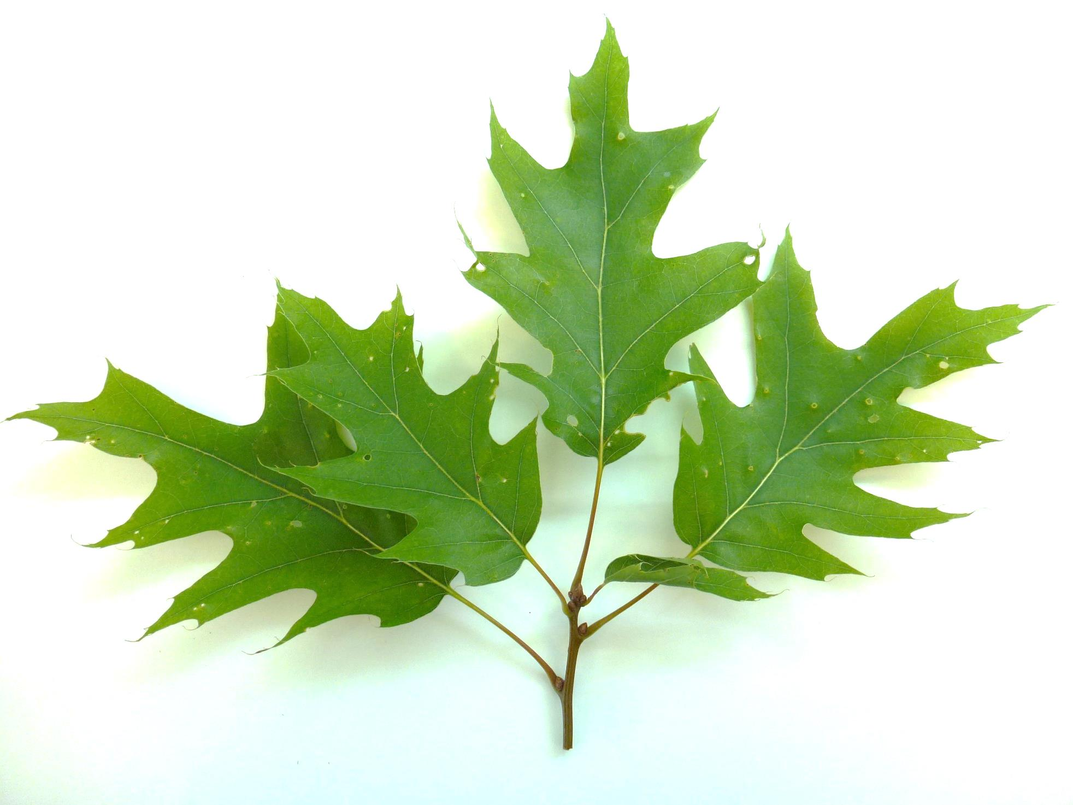

Slide 20
